Slide 1

American sign language (ASL) to text conversion using CNN
Capstone Project Phase 2 - 23-2-D-4
Supervisor:
Miri Weiss Cohen
Submates:
Michael Ohayon
Ido Mialy
Page 1 of 23

Slide 2
Table of contents
01
Problem Motivation
02
Requirements
03
ASL App
04
Training process
05
Hyperparameters
Demonstration
06
Challenges
07
Page 2 of 23

Slide 3
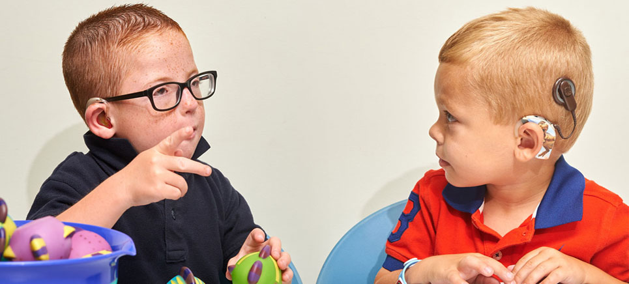
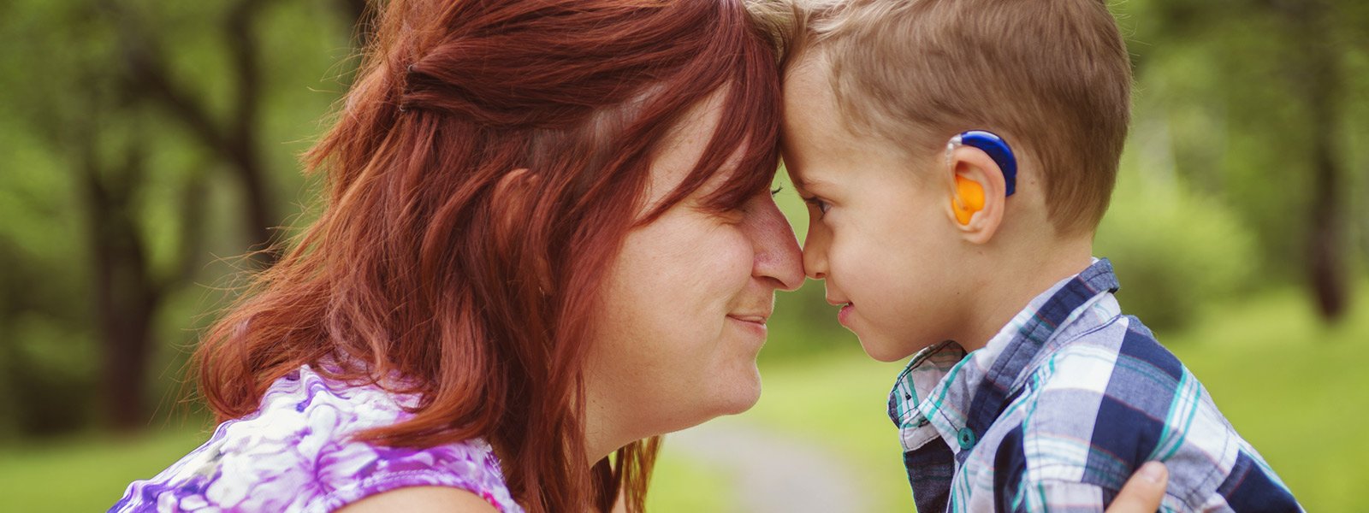
Problem
01
According to the World Health Organization (WHO), approximately 70 million hearing-impaired and deaf individuals worldwide use sign language for communication. In the United States alone, 500,000 hearing-impaired and deaf individuals rely on American Sign Language (ASL) for communication.
Page 3 of 23

Slide 4
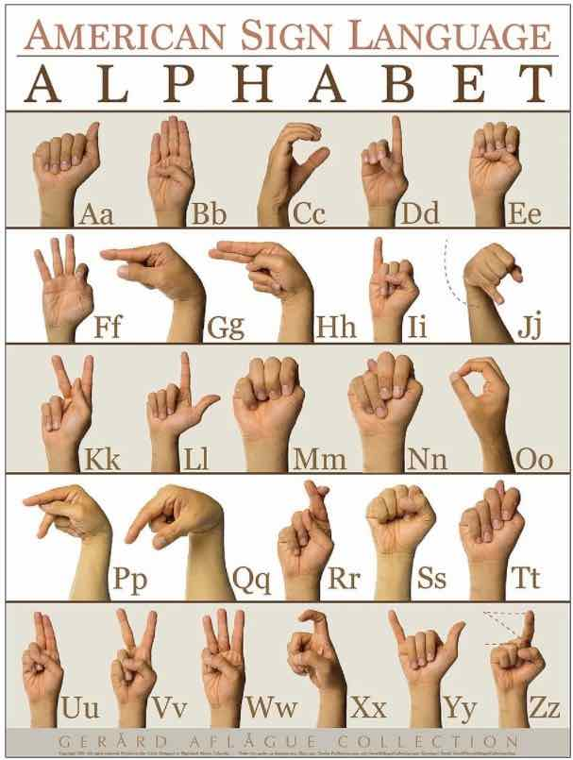
American Sign Language (ASL)
Problem
01
ASL is a complete, natural language used by the Deaf community in the world. One fundamental aspect of ASL is its system of letters, which correspond to the alphabet in spoken languages.
Each letter in ASL is expressed through unique handshapes and movements.
Page 4 of 23

Slide 5
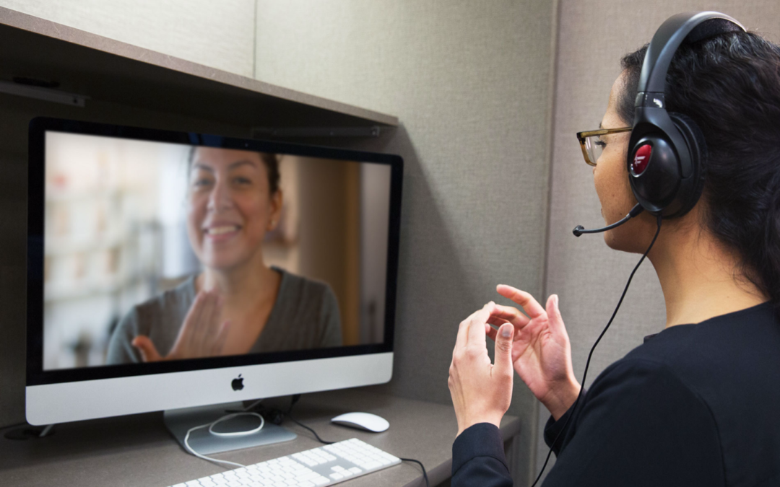
Motivation
01
ASL users and hearing people face a big communication barrier. This makes it hard to understand each other, limits social inclusion, and hampers equal participation in life.
We want to Overcoming this communication barrier for a better world!
Page 5 of 23

Slide 6
Requirements
02
Real-time operation: System must process input instantly for seamless communication.
High-speed performance: Swift recognition of gestures without delay ensures efficient interaction.
Accuracy in gesture recognition: Precise interpretation of ASL gestures for effective communication.
Reliable functioning: Consistent performance across varied conditions ensures dependable usage.
Page 6 of 23

Slide 7
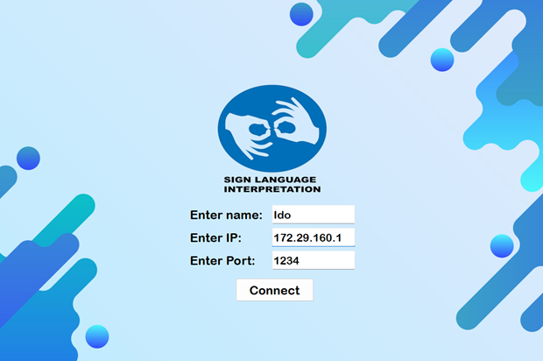
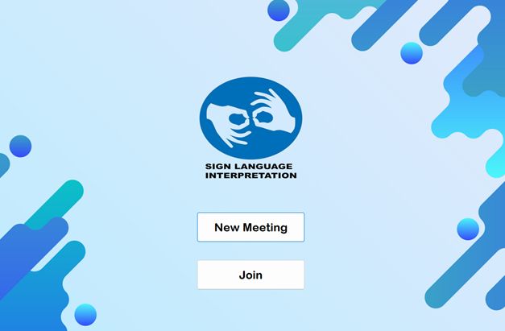
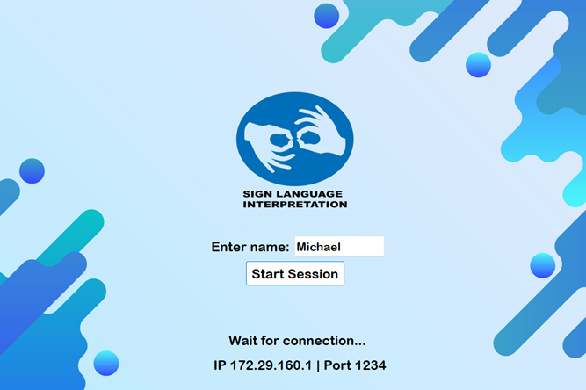
ASL App
03
Page 7 of 23

Slide 8
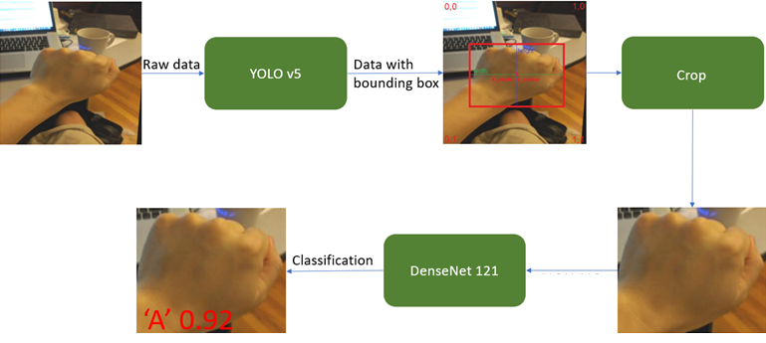
ASL App Recognition Flow
03
Page 8 of 23

Slide 9
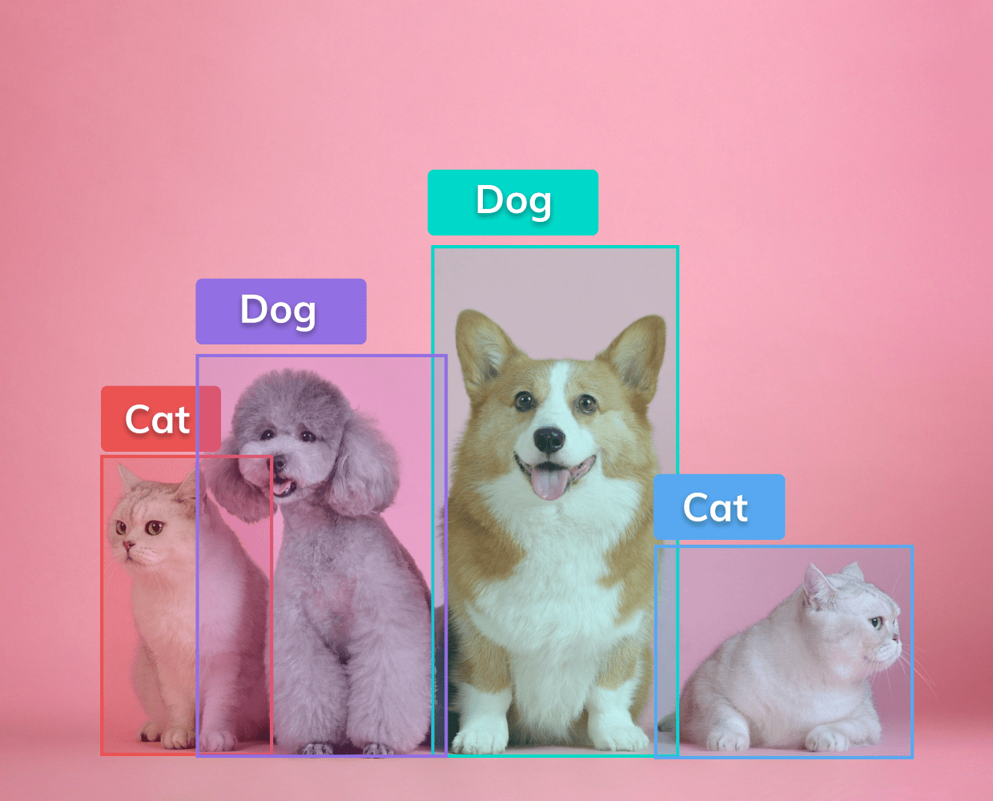
YOLO
03
YOLO - “YOU ONLY LOOK ONCE” is an algorithm that uses neural networks to provide real-time object detection.
YOLO combines object localization and classification to detect and locate objects in an image.
The YOLO network has three main components: 1. Backbone - aggregates image features 2. Neck - mixes and combines features 3. Head - generates box and class predictions
Page 9 of 23

Slide 10
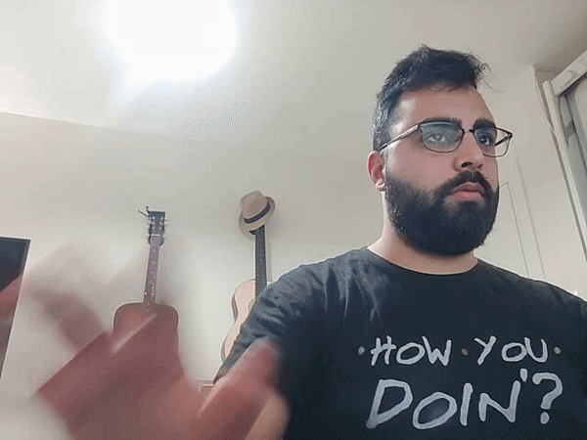
YOLOv5
03
The webcam's video feed undergoes processing through the YOLOv5 neural network, pinpointing and isolating the user's hand movements.
Each frame of the video feed is analyzed sequentially, with YOLOv5 detecting the hand and overlaying a bounding box, accompanied by an audible signal.
Page 10 of 23

Slide 11
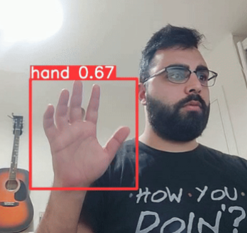
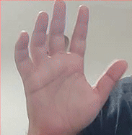
Crop
03
To enhance ASL gesture classification, we utilize YOLO's bounding box output to extract hand data.
This data is then fed into DenseNet for letter recognition, ensuring precise classification.
Page 11 of 23

Slide 12
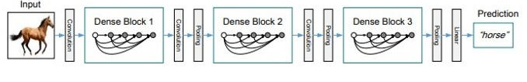
DenseNet
03
DenseNet is a deep neural network architecture that connects each layer to every other layer in a feed-forward fashion, enabling efficient feature reuse.
In DenseNet, each layer receives input from all preceding layers, creating a dense block of interconnected layers.
Page 12 of 23

Slide 13
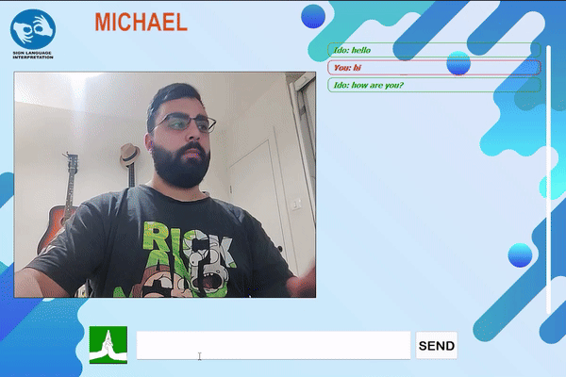
DenseNet121
03
After the YOLOv5 hand detection and cropping, we feed the output into DenseNet121 for ASL gesture classification in real time. By merging YOLOv5 bounding box labels with DenseNet results, we achieve enhanced accuracy and real-time display of recognized gestures.
Page 13 of 23

Slide 14
Predicted letters history algorithm
03
Analyzes last 10 frames, achieving 70%-100% accuracy threshold.
Outputs converted to text, displayed in user's ASL text box.
Enables efficient communication, showcasing tech integration with real-world impact.
Page 14 of 23

Slide 15
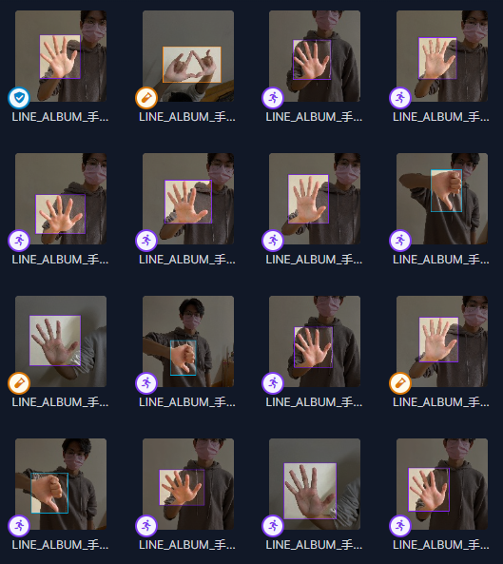
Training process YOLOv5
04
We began with transfer learning from yolov5l6 base weights. Training YOLOv5 on the Roboflow dataset (yolo-l2z3w_dataset) with around 790 images. While YOLOv5 trained for 10 epochs showed good accuracy, we observed accuracy and loss plateauing in the last 5 epochs. Hence, we chose the 5-epoch model for similar performance with fewer resources.
Page 15 of 23

Slide 16
Training process YOLOv5
04
Upon deploying the YOLOv5 model on our webcam feed, we noticed limitations in detecting certain movements and hand angles.
To address this, we employed a cascading approach, augmenting our dataset with an additional 40 custom-made images. Despite these enhancements, accuracy and loss remained unchanged.
Page 16 of 23

Slide 17
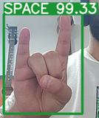
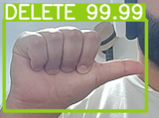
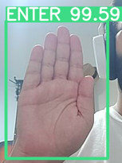
Training process DenseNet121
04
Secondly, We initiated learning from DenseNet121 base weights using transfer learning. We trained the DendeNet121 on our custom datasets, comprising approximately 580 images of American Sign Language (ASL) letters.
Our dataset contains all the ASL letter (A-Z) and 3 special gestures: - SPACE: Adding a space between letters.
- DELETE: Delete the last letters.
- ENTER: Works as Enter to send the message.
Page 17 of 23

Slide 18
Hyperparameters
Experiments
05
We Explored different iterations, each representing unique combinations of hyperparameters and corresponding accuracy. Notably, the optimal accuracy, highlighted by categorical accuracy and loss metrics
# | lr | batch size | accuracy
1 | 0.01 | 16 | 0.92759
2 | 0.001 | 16 | 0.95624
3 | 0.0001 | 16 | 0.97224
YOLOv5
# | lr | batch size | accuracy | loss
1 | 0.001 | 16 | 0. 91379310 | 0.0189
2 | 0.001 | 32 | 0. 9827586 | 0.046771
3 | 0.0001 | 16 | 0.99987851 | 0.0023
4 | 0.0001 | 32 | 0. 9933298 | 0.046450
DenseNet121
Page 18 of 23

Slide 19
Hyperparameters
05
YOLOv5: 1. Learning Rate(LR) -0.001 2. Epochs - 10. 3. Batch Size – 16. 4. Loss function – Adam with smooth L1 function
DenseNet121: 1. Learning Rate(LR) - 0.0001. 2. Epochs - 200. 3. Batch Size – 16. 4. Loss function – Adam with default Cross Entropy Loss function. 5. Dropouts – 0.2.
Page 19 of 23

Slide 20
Challenges
06
Expected Challenges
Dataset: Acquiring sufficient images for accurate DenseNet121 training. Custom dataset creation tackled issues of inaccurate gesture detection and overfitting. Mixed dataset approach effectively addressed overfitting and improved model performance.
Real-Time Inference: Achieving low-latency predictions with high accuracy requires optimized model architectures and hardware acceleration. Leveraging NVIDIA RTX 3090 GPU for real-time operation ensures seamless user experience.
Page 20 of 23

Slide 21
Challenges
06
Unexpected Challenges
Working Platforms: Exploring Google Colab and Jupyter Notebook for system development. Challenges encountered due to interface complexities and hardware dependencies, leading to the search for alternative solutions.
Integration: Difficulties integrating YOLOv5 and DenseNet121 into the project due to runtime, input requirements, and training disparities. Decision to customize models for project needs overusing off-the-shelf solutions.
Page 21 of 23

Slide 22
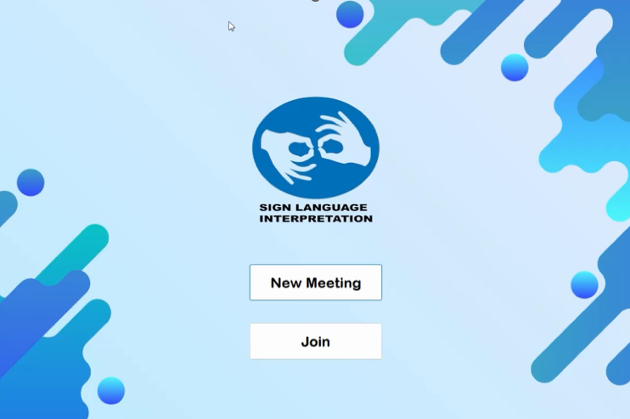
Demonstration
07
Page 22 of 23

Slide 23
Thank you!
Michael Ohayon Ido Mialy
Page 23 of 23

